Slide 1
Multi-Switch Cooperative Sketch-based Monitoring
Wei-Te Lu 呂韋德
Advisor：Ching-Ju Lin 林靖茹

Slide 2


Network Measurement
Foundation for Network applications
Network Measurement
Network Monitoring
Network Security
Analysis
Defense

Slide 3



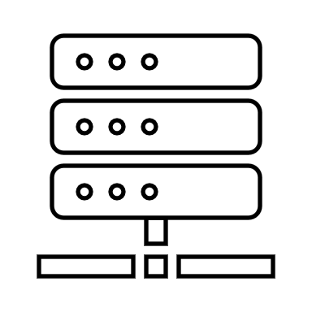

Existing Measurement Methods
4+1 | 52 | 31
5 | 20 | 3+1
14 | 2+1 | 9
74+1 | 3 | 6
h1(.)
h2(.)
F2
F1
h3(.)
h4(.)
sample
FLOW
FLOW
FLOW
Sample
Sketch
Network Measurement
Notes:
Partial/Sampling Only sample packets or flows, or collect detailed statistics based on a preconfigured list of conditionals.
Sketch-based Collects the information of every packet in a compact data structure, namely sketch, on network devices.

Slide 4
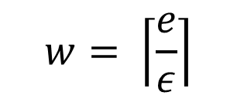
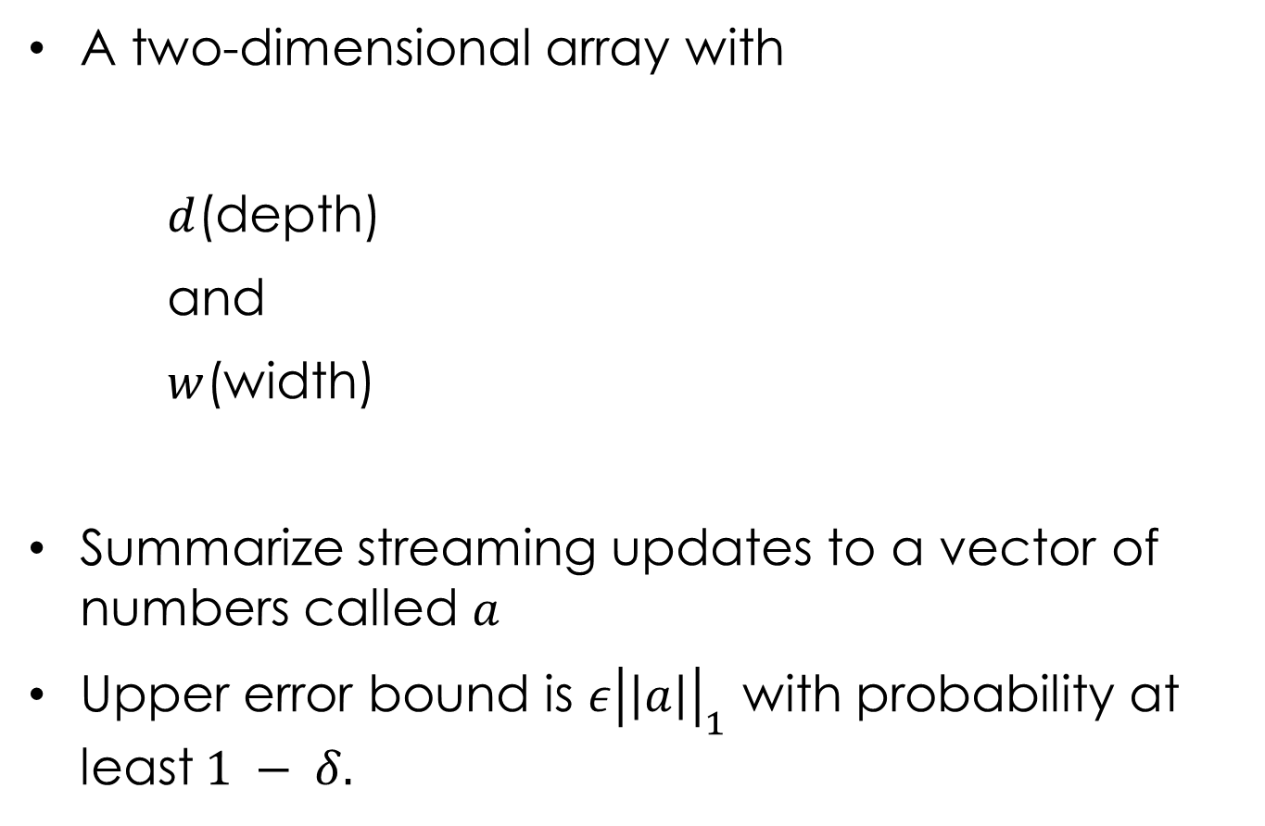
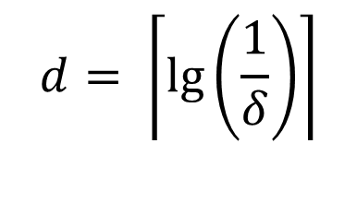
Sketch
A two-dimensional array with
$d$(depth)
and
$w$(width)
Summarize streaming updates to a vector of numbers called $a$
Upper error bound is $ε{\left|\left|a\right|\right|}_{1}$ with probability at least$1 − δ.$
w=3
$$d= \left\lceil \lg\left(\frac{1}{δ}\right)\right\rceil$$
h1(.)
0 | 0 | 0
0 | 0 | 0
0 | 0 | 0
0 | 0 | 0
h2(.)
$$w= \left\lceil \frac{e}{ε}\right\rceil$$
d=4
h3(.)
h4(.)

Slide 5
CM-Sketch
Add
Query
0+1 | 0 | 0
0 | 0 | 0+1
0 | 0+1 | 0
0+1 | 0 | 0
h1(.)
h2(.)
F2
F1
h3(.)
h4(.)
4 | 52 | 31
5 | 20 | 3
14 | 2 | 9
74 | 3 | 6
h1(.)
h2(.)
Packets of
Flow ID(or 5-turple) = min(4,3,2,74) = 2
Flow ID(or 5-turple)
h3(.)
h4(.)

Slide 6
Sketch-Based Monitoring
Sketch based
Count-Min(CM) Sketch
Count Sketch
Univmon
……
Hybrid Sketch Algorithm
Elastic Sketch
HybridSketch
……

Slide 7
Sketch-Based Monitoring
Pros
Memory & Accuracy Tradeoff
Efficiency
Generality [Univmon, Sigcomm16]

Slide 8






Sketch-Based Monitoring
Cons
Collision
Single Switch
F1
0 | 0 | 0 | 0 | 0 | 0
0 | 0 | 1 | 0 | 0 | 0
0 | 0 | 2 | 0 | 0 | 0
F2

Slide 9
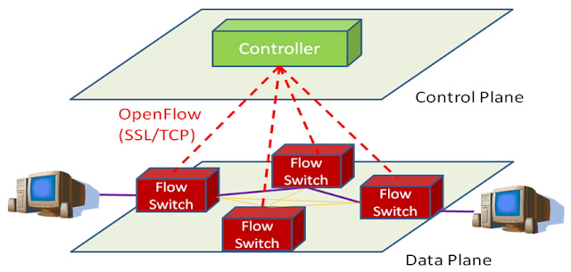

Sketch-Based Monitoring

Slide 10





Traditional Way
F4
F3
F2
F1
718 | 2041 | 262 | 593 | 362 | 903
F4
F3
F2
F1
S1
S3
705 | 2031 | 242 | 793 | 462 | 803
F4
F3
F2
F1
703 | 2231 | 442 | 393 | 862 | 603
F4
F3
F2
F1
S2
S4
765 | 1831 | 212 | 693 | 562 | 903

Slide 11

Ideal Way
F3
18 | 41 | 262 | 93 | 32 | 93
F1
S1
S3
70 | 87 | 12 | 79 | 42 | 83
F4
703 | 31 | 42 | 33 | 62 | 63
F2
S2
S4
75 | 31 | 22 | 23 | 562 | 63

Slide 12






Goal
Multi-Switch Cooperative
Improve the situation of collision
Improve the worst ARE of all Flows
Enhance efficiency of switch process packets
Notes:
所有switch的合作，不需要每一個switch都去紀錄，而只要某幾個switch去紀錄就好。
有點像是分散式，合作式的sketch

Slide 13
Challenges
1. How to decide the allocation of flow?
Which Switch be responsible for which flow?
2. How to decide the routing path of flow?
Why we can’t use Dijkstra algorithm?
3. Which flow can get more resource?

Slide 14
Outline
Overview
Algorithm
Performance Evaluation
Conclusion

Slide 15
Problem Statement
Input
A set of switches and a set of flows
Task
Determine the routing path of flow
Determine the location of flow
Objective
Minimize the worst ARE of the set of flow

Slide 16
Flow Chart
End
No
Can its ARE be better?
Yes
Flows
Choose
Best switch
Choose the worst Flow
Compute the ARE of flow
Routing

Slide 17


How to decide the routing path of flow?
Shortest Path

Slide 18
How to decide the routing path of flow?
Longest Path

Slide 19
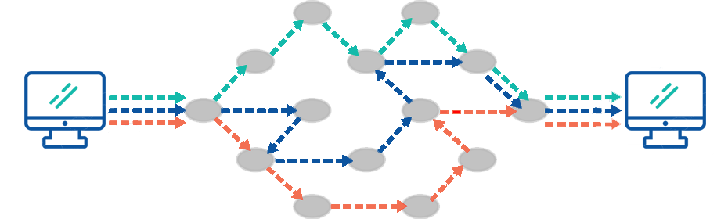
How to decide the routing path of flow?
K-Shortest path
Yen's Algorithm

Slide 20
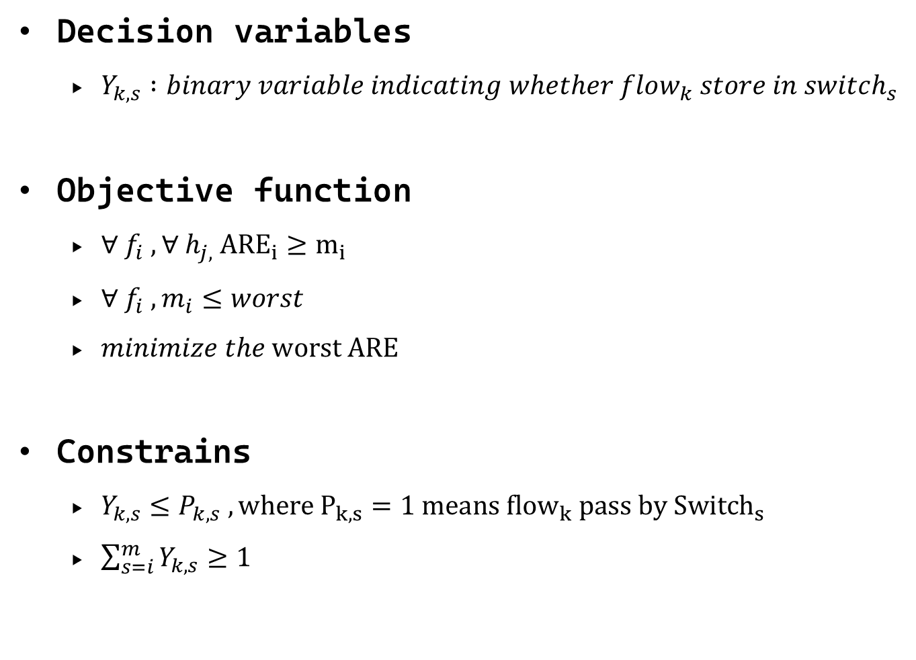
Problem Statement
Decision variables
$Y_{k,s} :binary variable indicating whether flow_{k} store in switch_{s}$
Objective function
$∀ f_{i} ,∀ h_{j,} {ARE}_{i}≥m_{i}$
$∀ f_{i} , m_{i}≤worst$
$minimize the worst ARE$
Constrains
$Y_{k,s}≤P_{k,s} ,where P_{k,s}=1 means {flow}_{k} pass by {Switch}_{s}$
$\sum_{s=i}^{m}{Y_{k,s}≥1}$

Slide 21
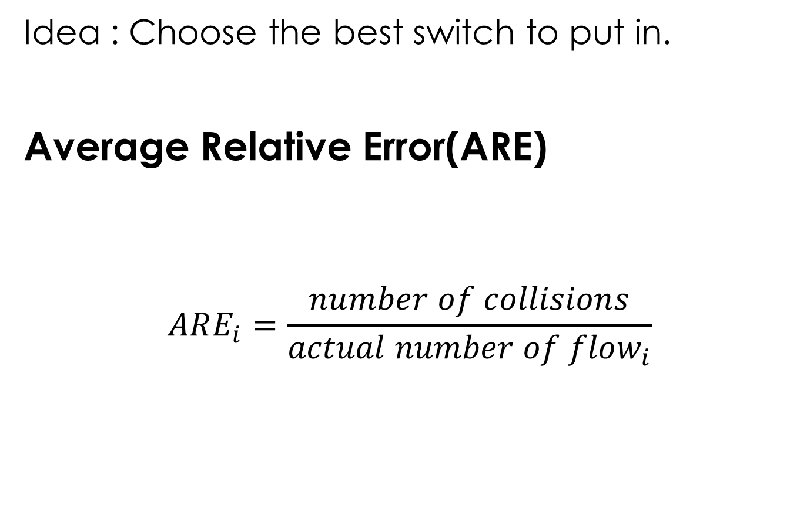
How to decide the allocation of flow?
Idea : Choose the best switch to put in.
Average Relative Error(ARE)
$$ARE_{i}=\frac{number of collisions}{actual number of flow_{i}}$$

Slide 22


Number of collision
How to get the number of collision of flow?
4 | 52 | 31
5 | 20 | 3
14 | 2 | 9
74 | 3 | 6
192.168.1.1
45 | 23 | 14
55 | 80 | 43
18 | 29 | 37
74 | 5 | 18

Slide 24
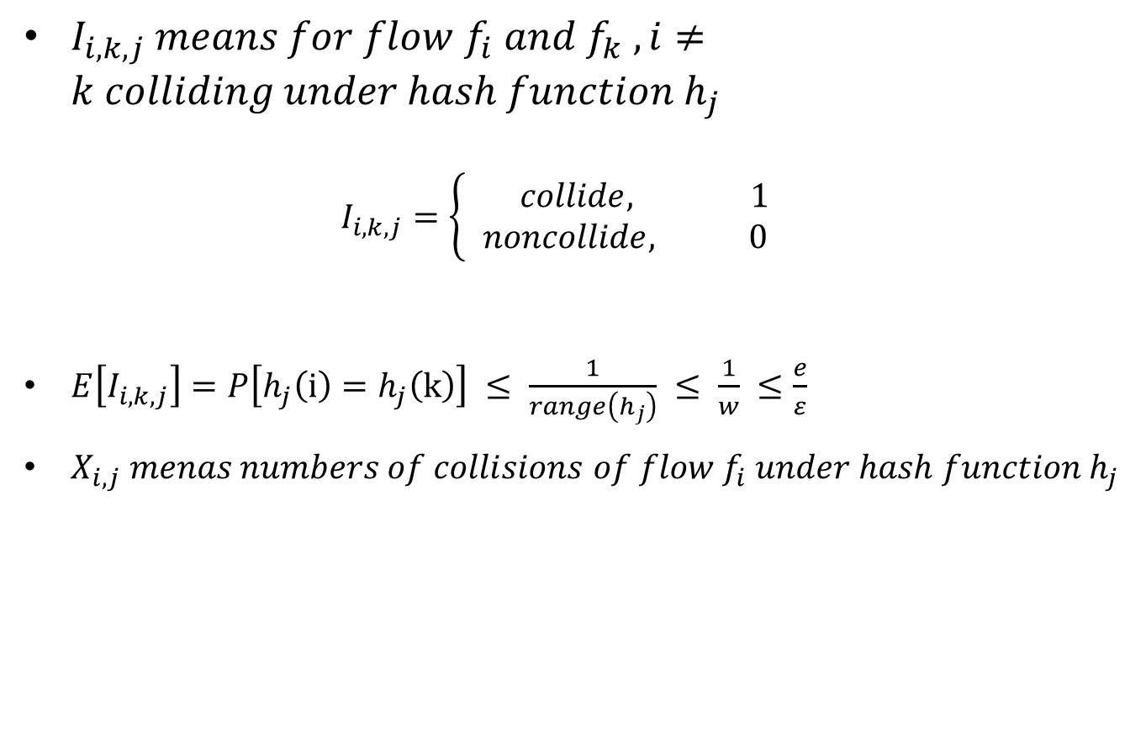
Number of collision
$I_{i,k,j} means for flow f_{i} and f_{k} ,i≠k colliding under hash function h_{j}$ $I_{i,k,j}=\left\{\begin{aligned} collide, 1 \\ &noncollide, 0\end{aligned}\right.$
$E\left[I_{i,k,j}\right]=P\left[h_{j}\left(i\right)=h_{j}\left(k\right)\right] ≤ \frac{1}{range\left(h_{j}\right)} ≤ \frac{1}{w} ≤\frac{e}{ε}$
$X_{i,j} menas numbers of collisions of flow f_{i} under hash function h_{j}$

Slide 25
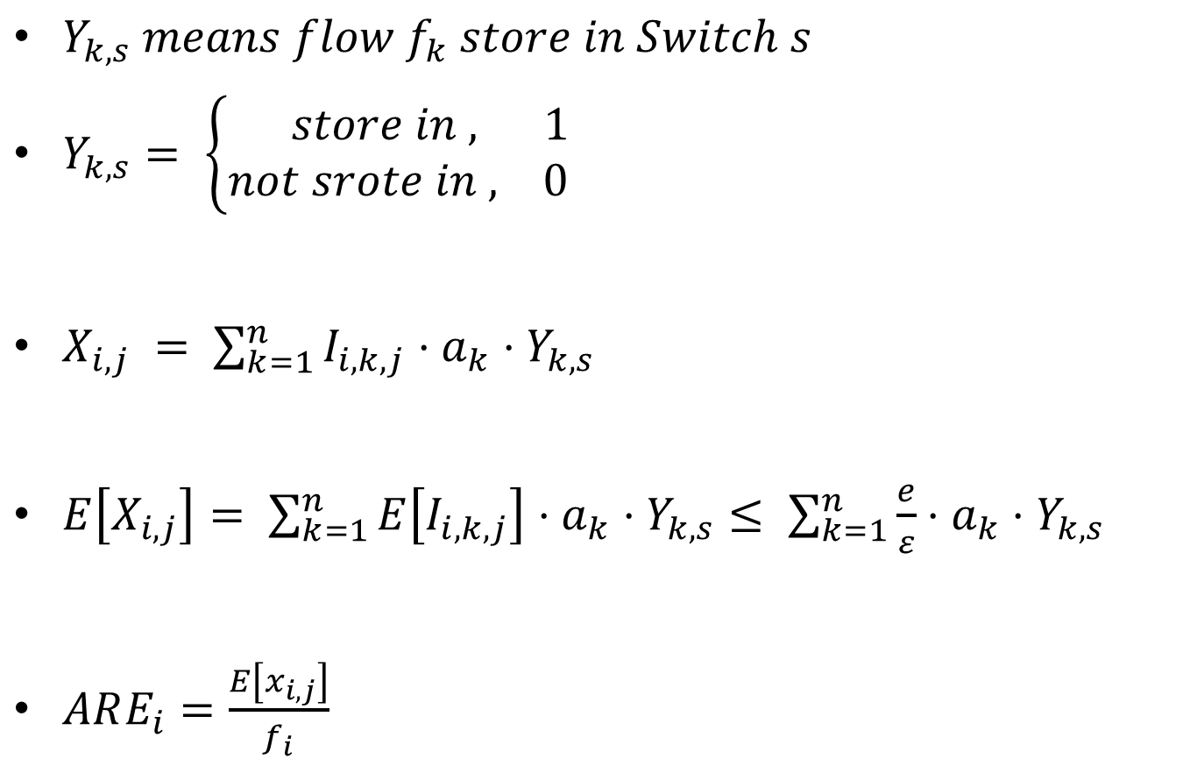
Number of collision
$Y_{k,s} means flow f_{k} store in Switch s$
$Y_{k,s}= \left\{\begin{aligned} store in , 1 \\ &not srote in , 0\end{aligned}\right.$
$X_{i,j} = \sum_{k=1}^{n}{I_{i,k,j}⋅a_{k}⋅Y_{k,s}}$
$E\left[X_{i,j}\right]= \sum_{k=1}^{n}{E\left[I_{i,k,j}\right]⋅a_{k}⋅Y_{k,s}}≤ \sum_{k=1}^{n}{\frac{e}{ε}⋅a_{k}⋅Y_{k,s}}$
$ARE_{i}=\frac{E\left[x_{i,j}\right]}{f_{i}}$

Slide 26
Outline
Overview
Algorithm
Performance Evaluation
Conclusion

Slide 27
Comparison Schemes and Metrics
Baseline schemes
Baseline1 : Original CM sketch
Baseline2 : Store in one switch that on the path using Dijkstra
Baseline3 : Store in one switch that is best in the topology
Performance metrics
Topology
Memory usage
Traffic

Slide 28
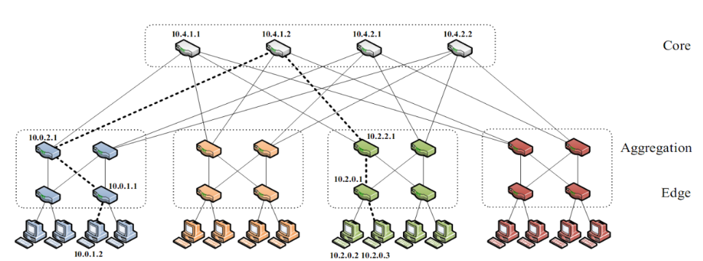



Topology
K-Ary Fat Tree
K = 6, K = 4
K = 4-1 , k = 4-2 , k = 4-3

Slide 29
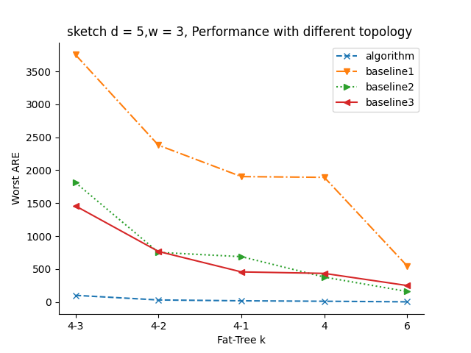
Worst ARE with Different Topology

Slide 30
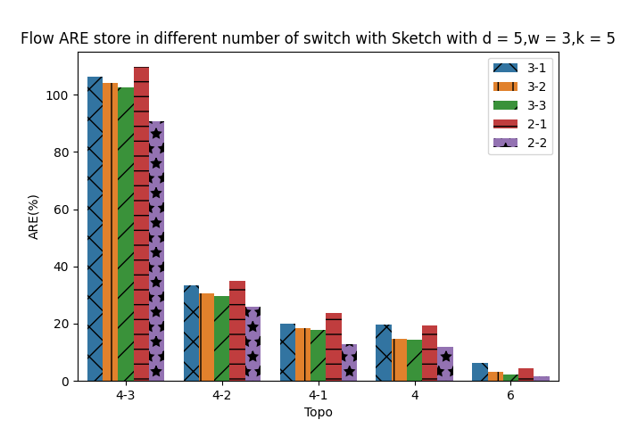
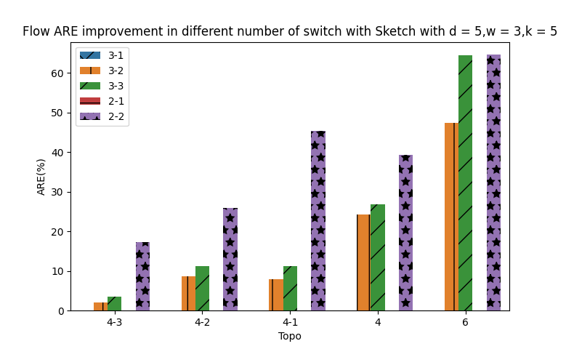

Slide 31
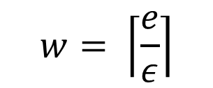
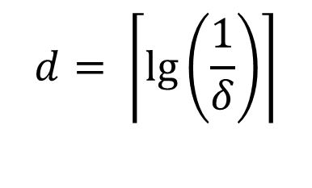
Memory Usage
D = 5(95%), w = 3(0.9), w = 6(0.45), w = 9(0.3)
D = 6, w = 9
$$d= \left\lceil \lg\left(\frac{1}{δ}\right)\right\rceil$$
$$w= \left\lceil \frac{e}{ε}\right\rceil$$

Slide 32
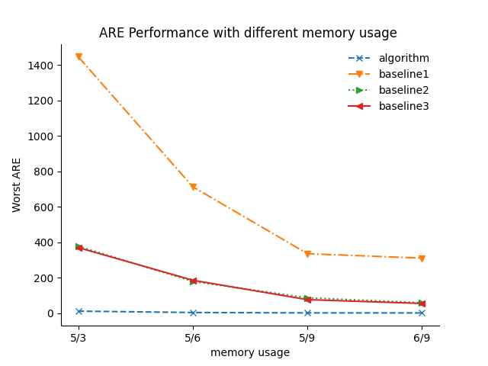
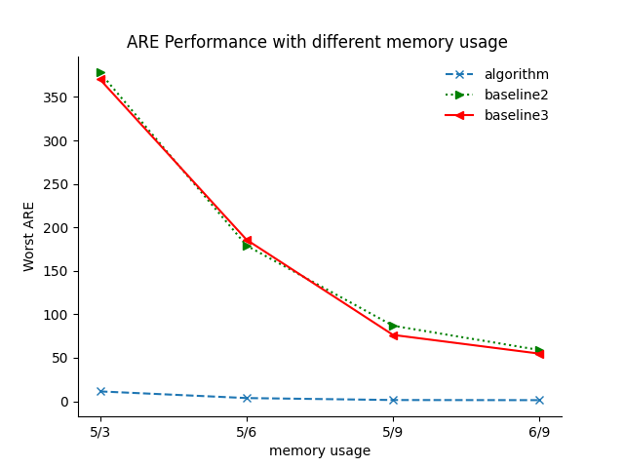
Worst ARE with Different Memory

Slide 33
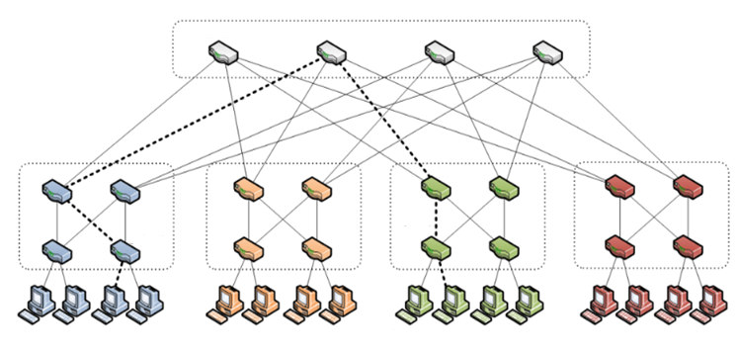
Traffic
Change the location of Src and Dst

Slide 34
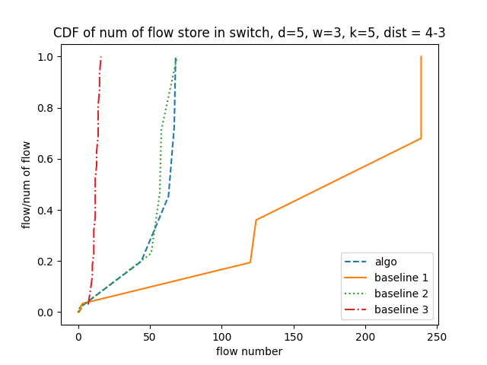
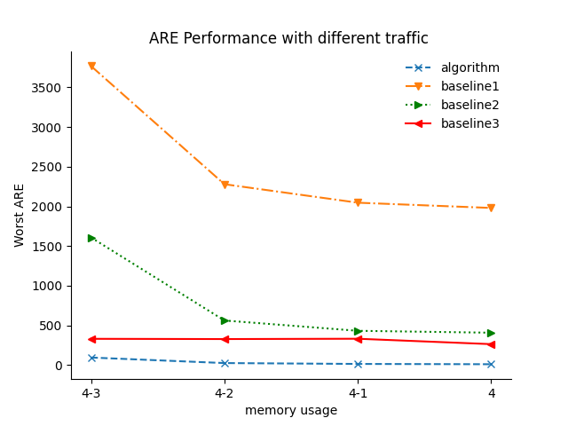
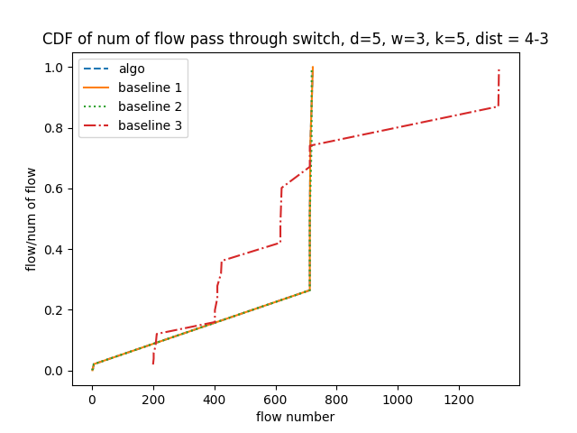

Slide 35
Outline
Overview
Algorithm
Performance Evaluation
Conclusion

Slide 36
Conclusion
Algorithm : A distributed system of Sketch based algorithm
Improve the situation of collision
Improve the worst ARE of all Flows
Enhance efficiency of switch process packets

